Slide 1


Slide 2
About Today…
PostgresQL
Joins
Transactions

Slide 3
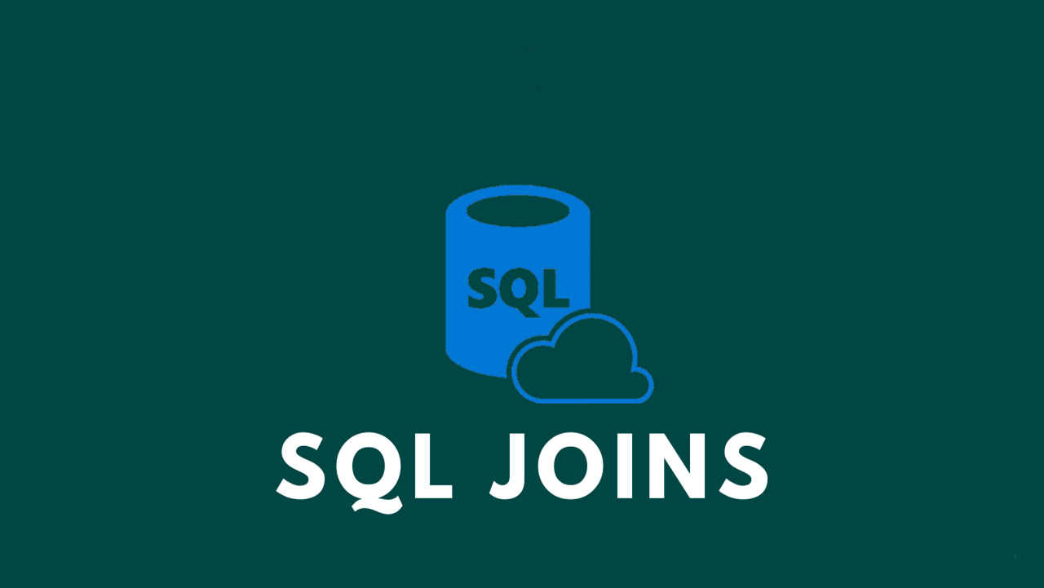

Slide 4

Introduction to Joins
Definition
A join is a SQL operation that combines data from two or more tables based on a related column
Purpose
To retrieve data from multiple tables in a single query
To enable complex queries that provide a comprehensive view of related data
Basic Syntax

Slide 5
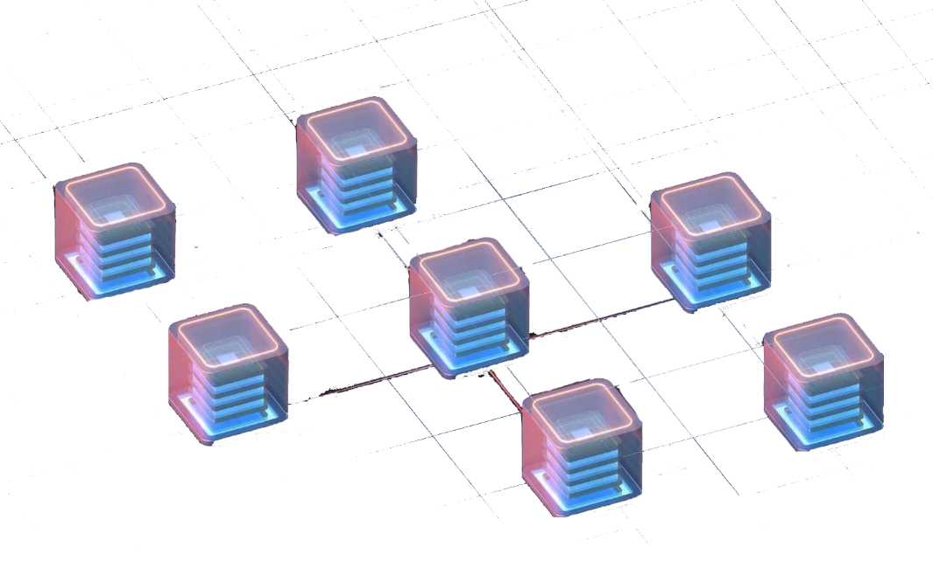
Types of Joins
Inner Join
Returns only the rows with matching values in both tables
Left Join
Returns all rows from the left table and the matched rows from the right table
Right Join
Returns all rows from the right table and the matched rows from the left table
Full Join
Returns all rows when there is a match in either left or right table
Cross Join
Returns the Cartesian product of the two tables

Slide 6


Inner Join
Definition
An Inner Join returns only the rows that have matching values in both tables
Syntax
Explanation
This query retrieves the names of employees and their corresponding department names where the department IDs match in both tables
Example

Slide 7


Left Join
Definition
Returns all rows from the left table and the matched rows from the right table. If no match is found, NULL values are returned for columns from the right table
Syntax
Explanation
This query retrieves all employees and their department names. If an employee is not assigned to any department, the department name will be NULL
Example

Slide 8


Right Join
Definition
Returns all rows from the right table and the matched rows from the left table. If no match is found, NULL values are returned for columns from the left table
Syntax
Explanation
This query retrieves all departments and the names of employees in those departments. If a department has no employees, the employee name will be NULL
Example

Slide 10
Intro to Transactions
Definition
A sequence of operations performed as a single logical unit of work
Purpose
To ensure data integrity and consistency
To allow for rollback of operations if an error occurs
ACID Properties
Atomicity
Ensures that all operations within the transaction are completed; if not, the transaction is aborted
Consistency
Ensures that the database is in a consistent state before and after the transaction
Isolation
Ensures that transactions are isolated from each other until they are completed
Durability
Ensures that the results of a transaction are permanently stored in the database once it is committed

Slide 11
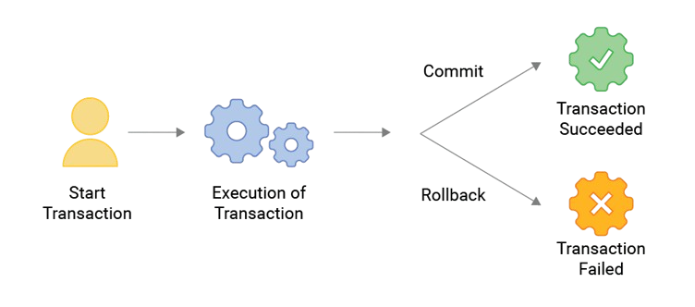

Starting a Transaction
Syntax
Description
The BEGIN statement starts a new transaction
Example
Explanation
This transaction starts with the BEGIN statement, updates employee salaries in a specific department, and then commits the changes

Slide 12
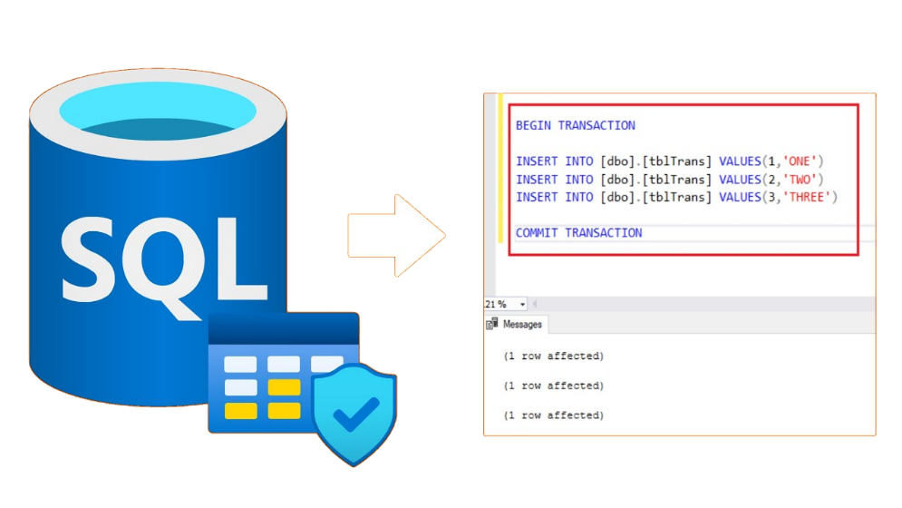
Committing a Transaction
Syntax
Description
The COMMIT statement saves all changes made during the transaction
Example
Explanation
This transaction updates employee salaries and then commits the changes, making them permanent in the database

Slide 13
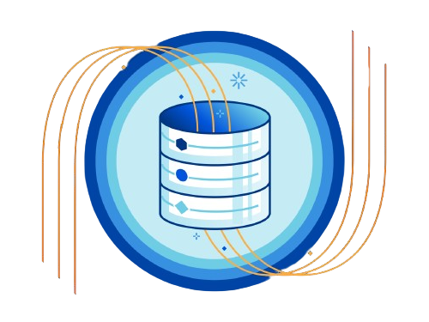
Rolling Back a Transaction
Syntax

Slide 14

What is a JOIN in SQL?
A SQL operation that combines rows from two or more tables based on a related column between them
What does a RIGHT JOIN return?
Returns all rows from the right table and the matched rows from the left table, with NULLs in place for unmatched rows
What is a transaction in the context of a database?
A sequence of one or more SQL operations that are executed as a single unit of work
What is the purpose of the BEGIN statement in PostgreSQL?
Marks the start of a transaction
What does the COMMIT statement do in a transaction?
Saves all changes made during the transaction to the database

Slide 15

Task 1
Write a query to list all orders along with the customer names using an INNER JOIN
Task 2
Start a transaction, insert a new employee into the employees table, and then commit the transaction

